Slide 1
AI BASED HOUSE SECURITY MODEL
Saurabh Pandey (RA2011003010207) ,
Naimish Pandey (RA2011003010147),
Aakash Chaudhary (RA2011003010159)

Slide 2
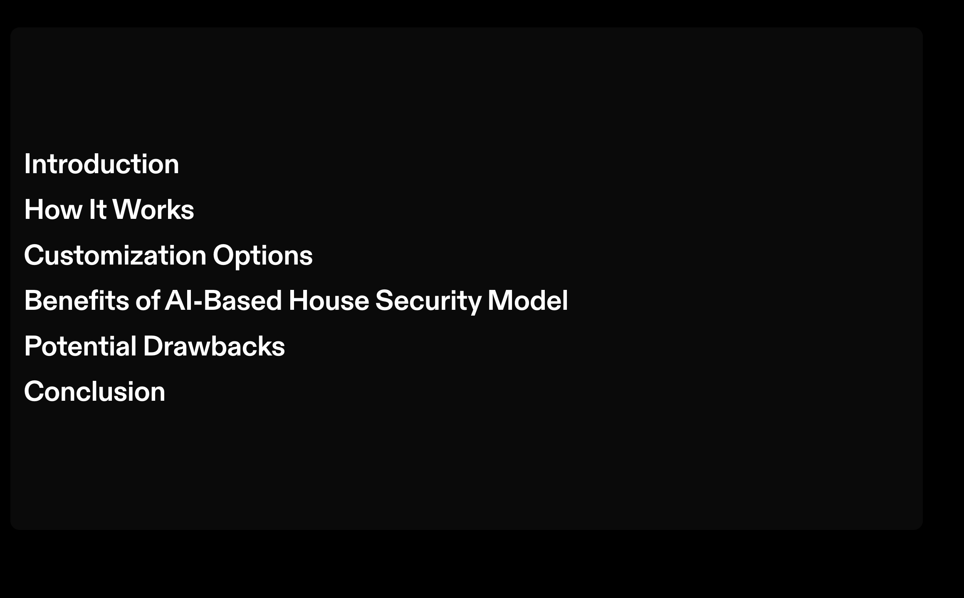

Slide 3
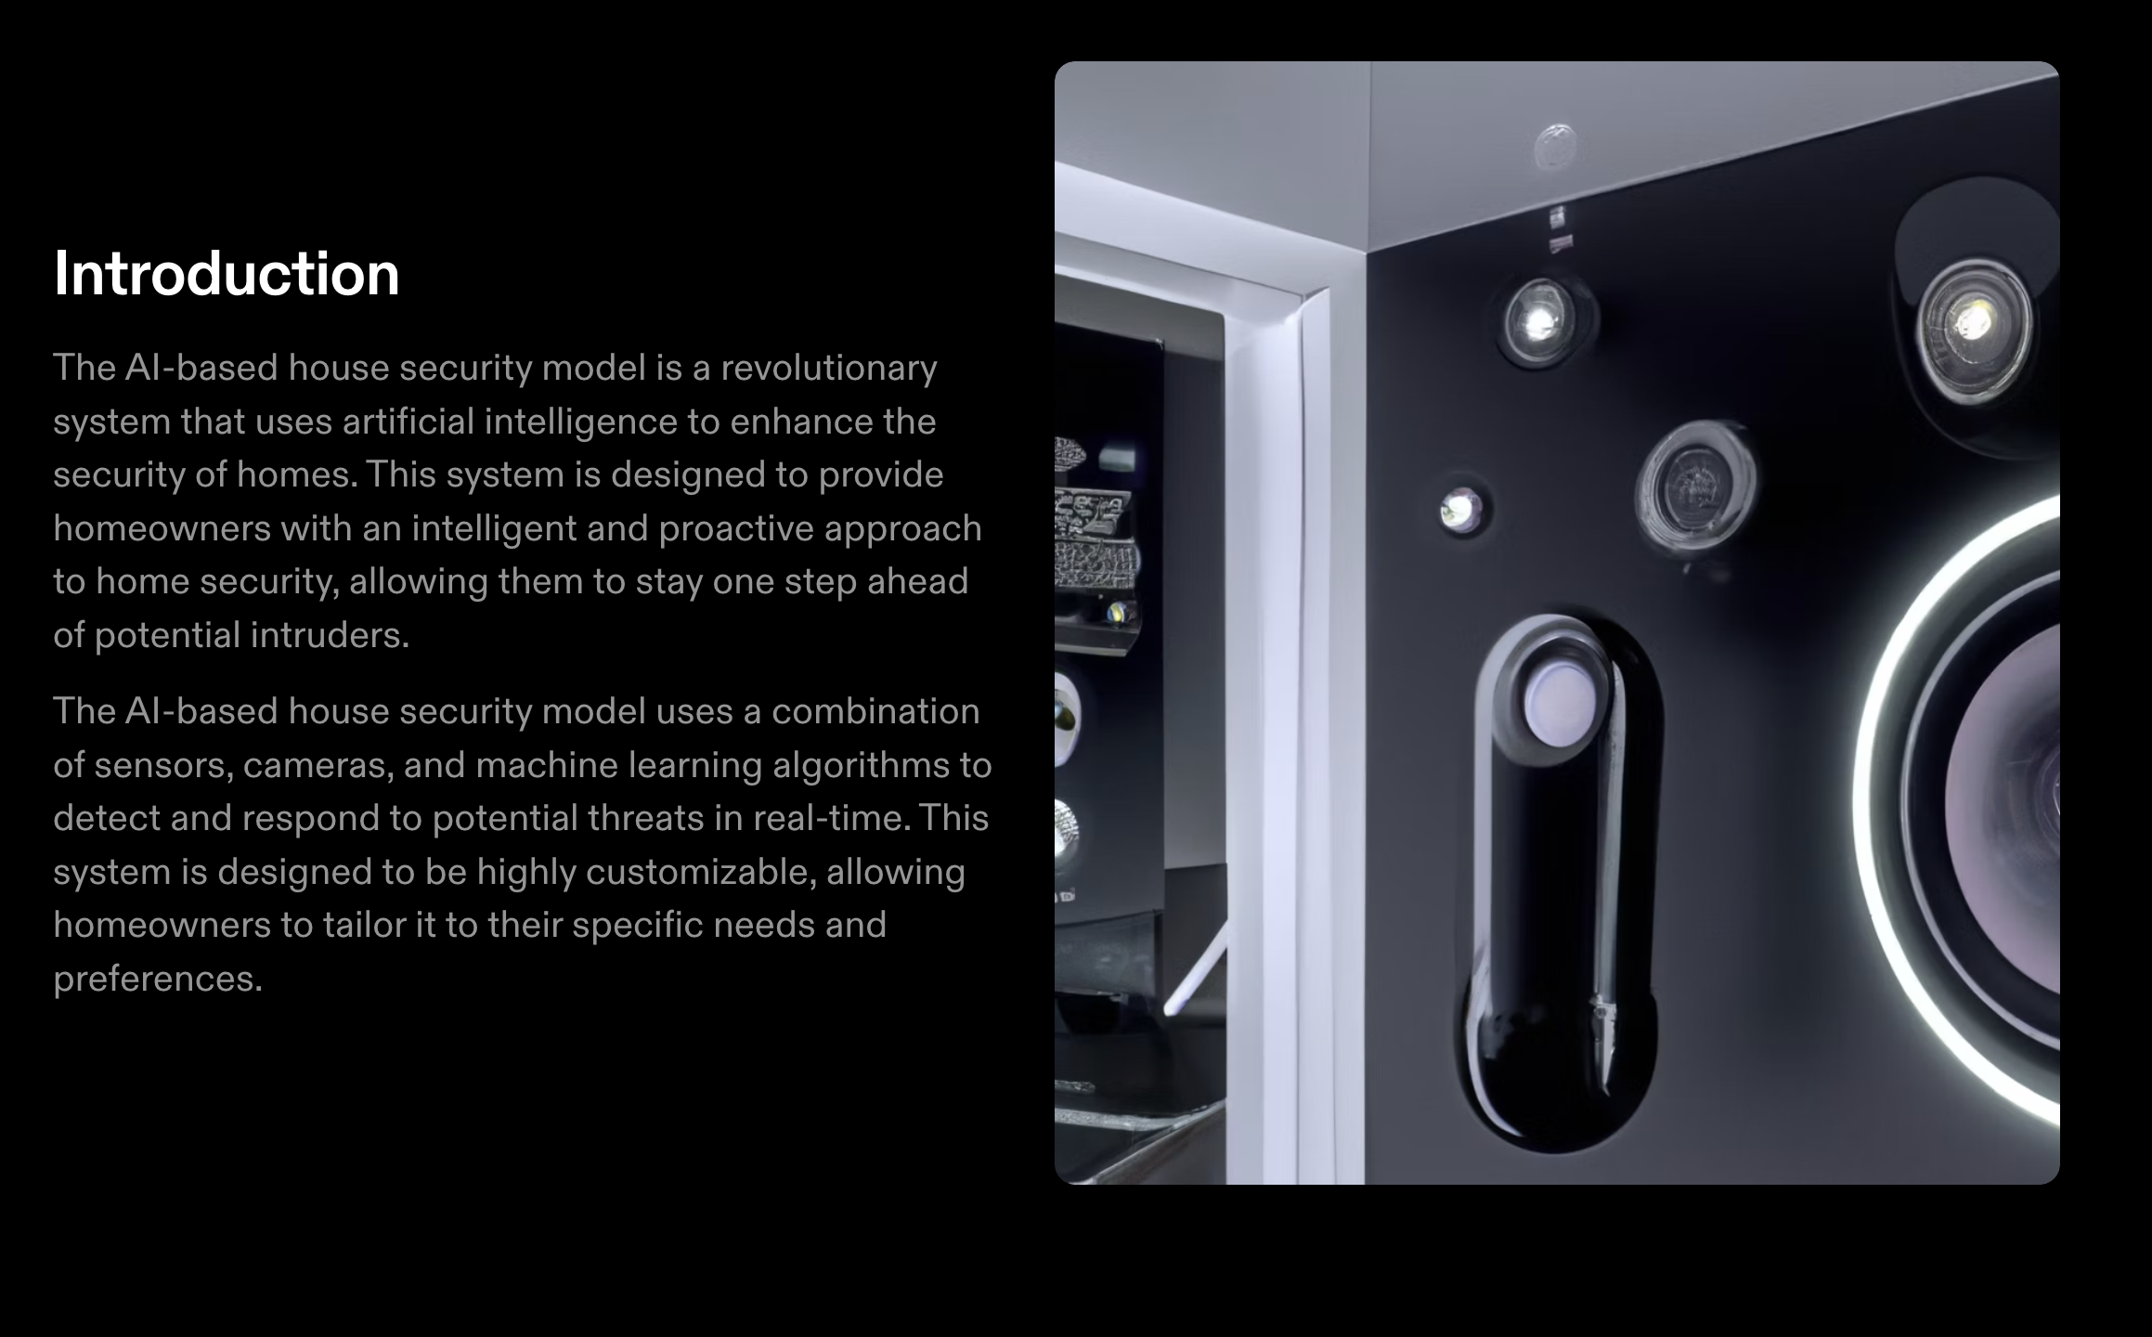

Slide 4
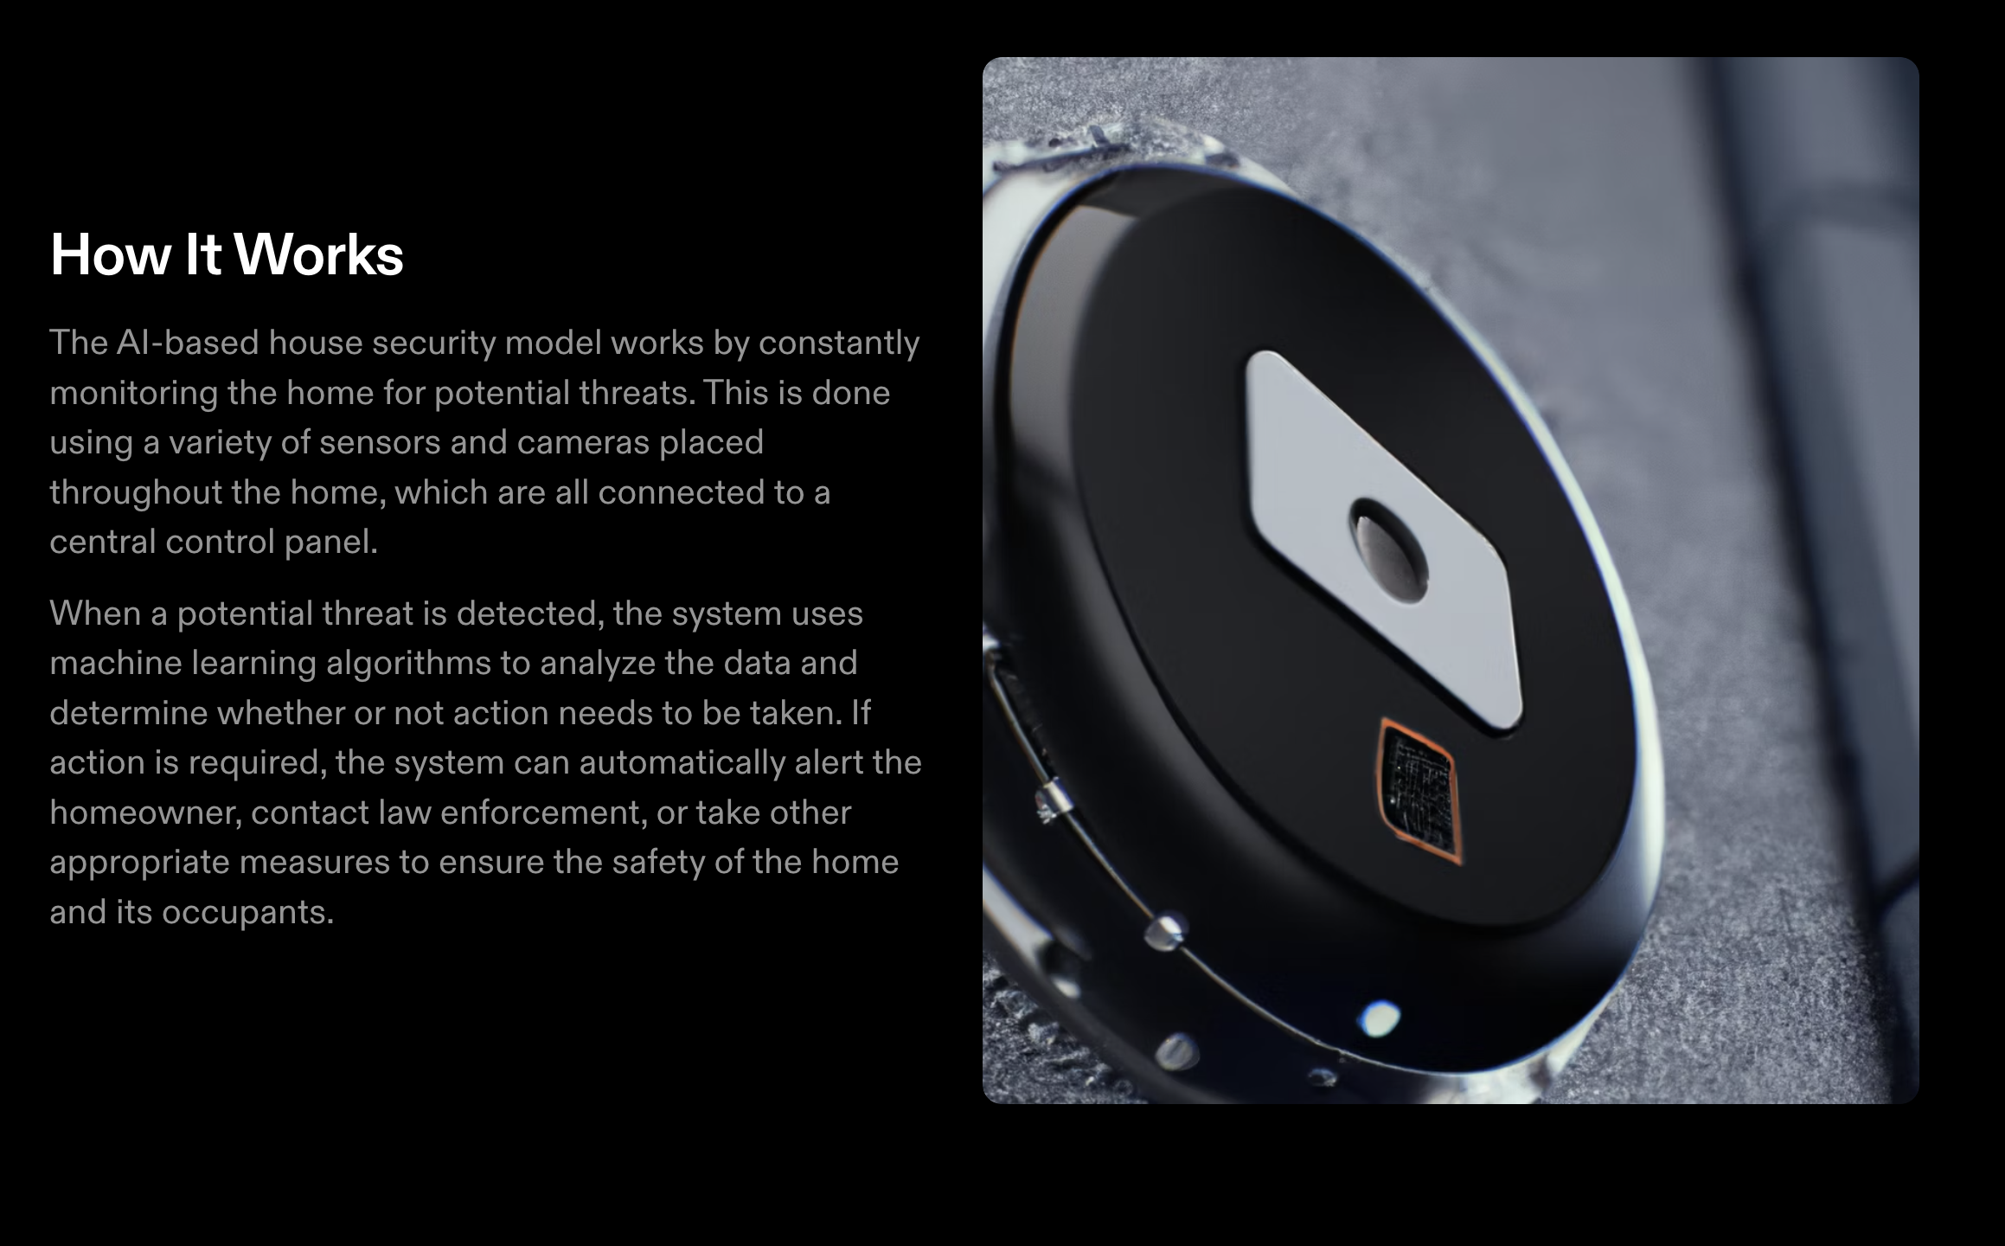

Slide 5
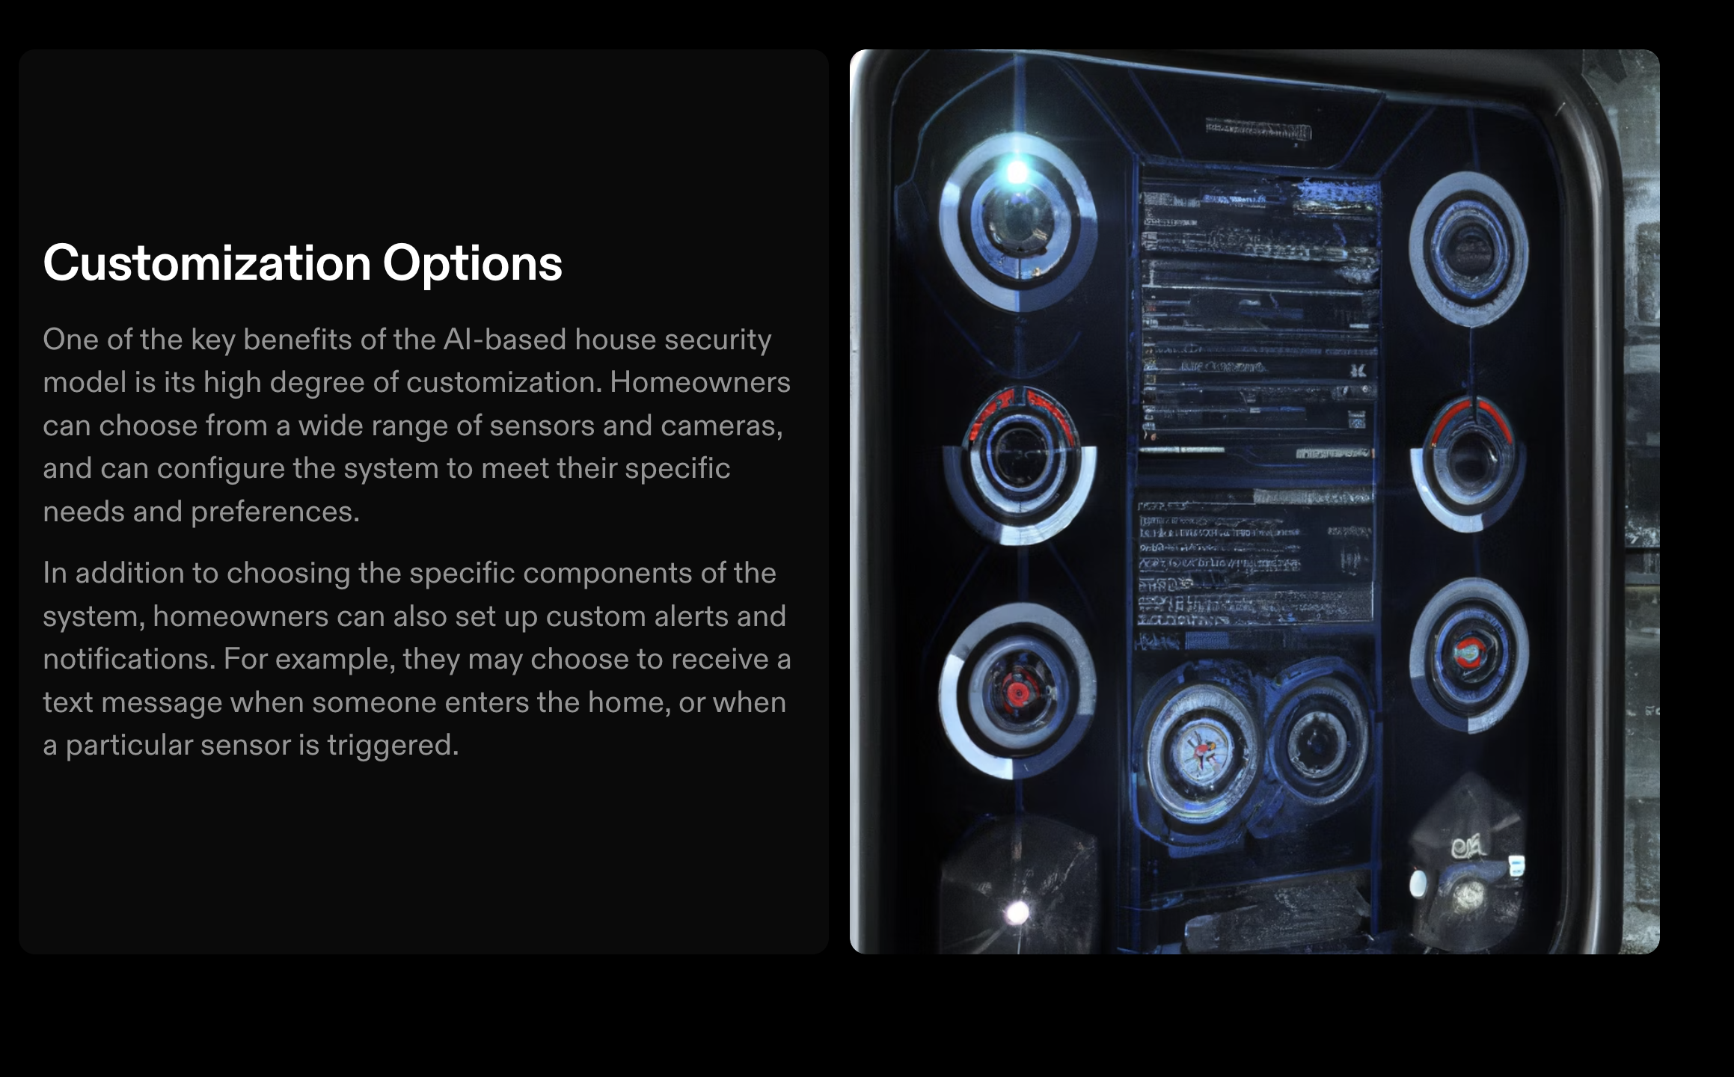

Slide 6
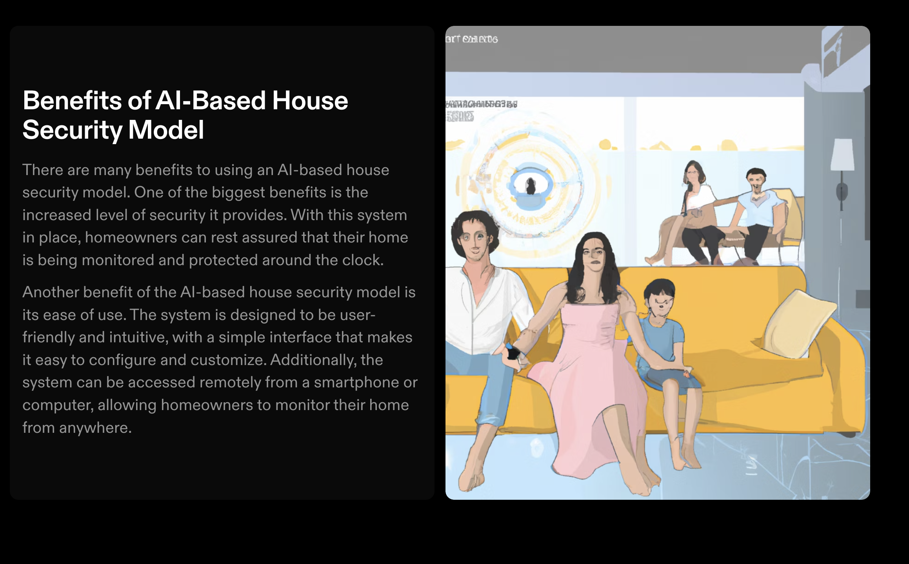

Slide 7
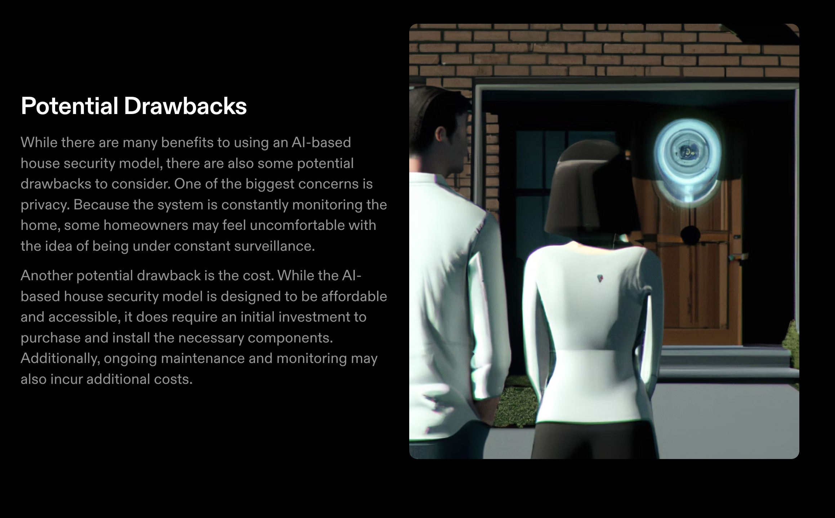

Slide 8
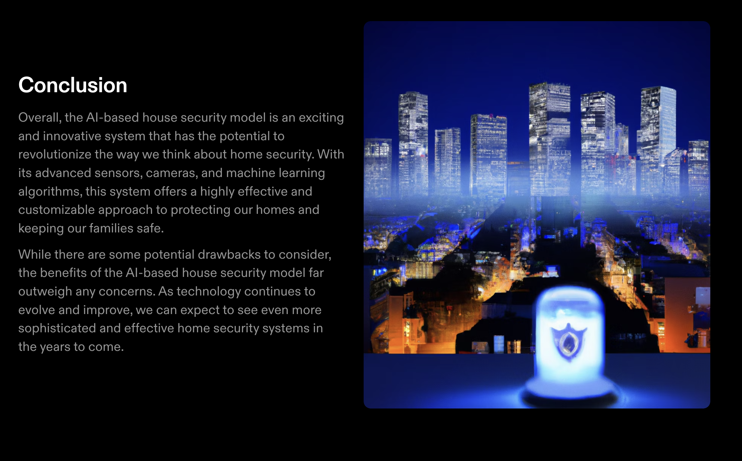

Slide 9
THANKYOU!!

